Slide 1
Robotics and IoT Club Secondary Years Level 2 - Week 7
Roohi Banu

Slide 2
Communication with Arduino
Serial Monitor
InfraRed (IR)
Bluetooth
RF
WiFi
Ethernet etc….

Slide 3
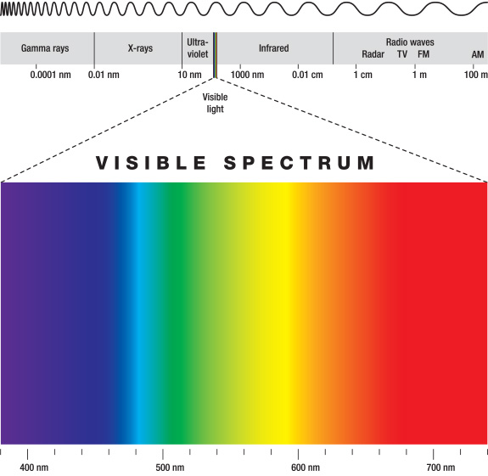
Bluetooth
www.bluetooth.com
Wireless communication between two devices
Transfers data through low power radio waves
It uses ISM radio frequency band for
communication (2.4 GHz to 2.485 GHz)
Uses very low power

Slide 4
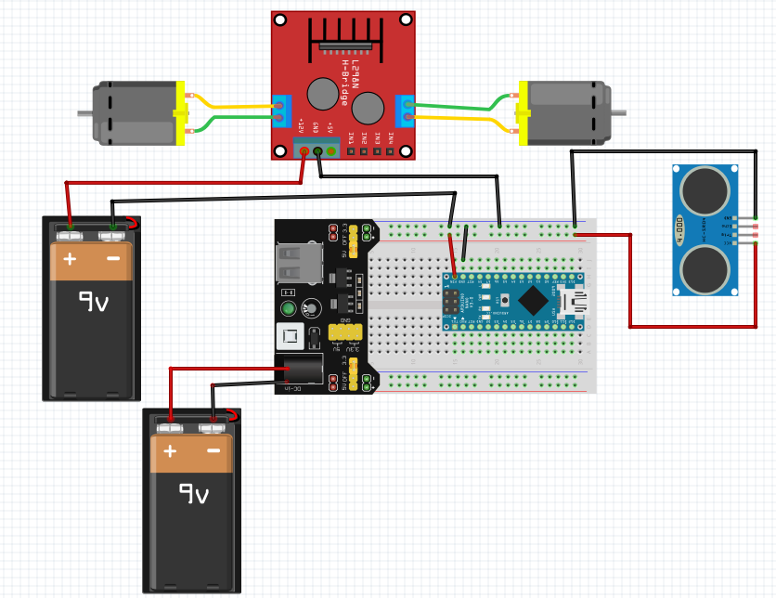
Power and Ground Connections

Slide 5
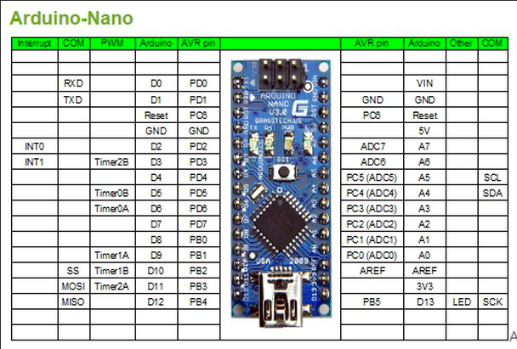
PWM Pins of Arduino

Slide 6
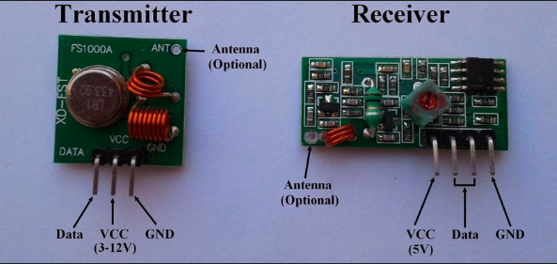
RF Communication – RF433
Radio Frequency Communication
It operates at a specific frequency of 433MHz.

Slide 7
RadioHead Library
Install ‘RadioHead’ Library
Sketch -> Include Library -> Manage Libraries
Search for ‘RadioHead’

Slide 8
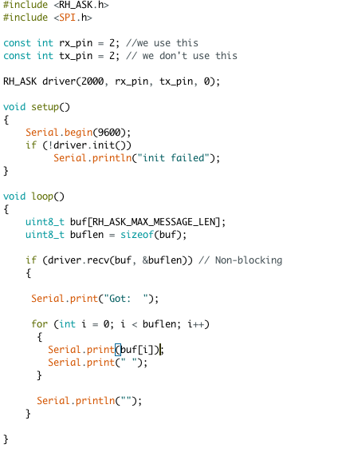
Receiver

Slide 9
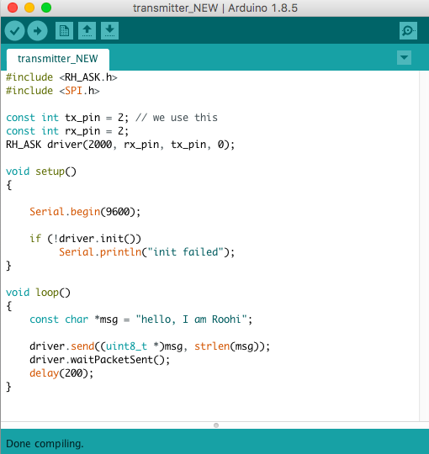
Transmitter

Slide 10
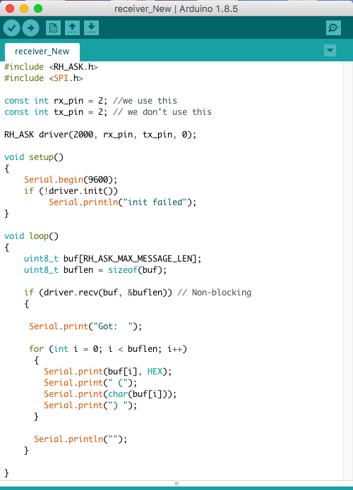
Arduino Code

Slide 11
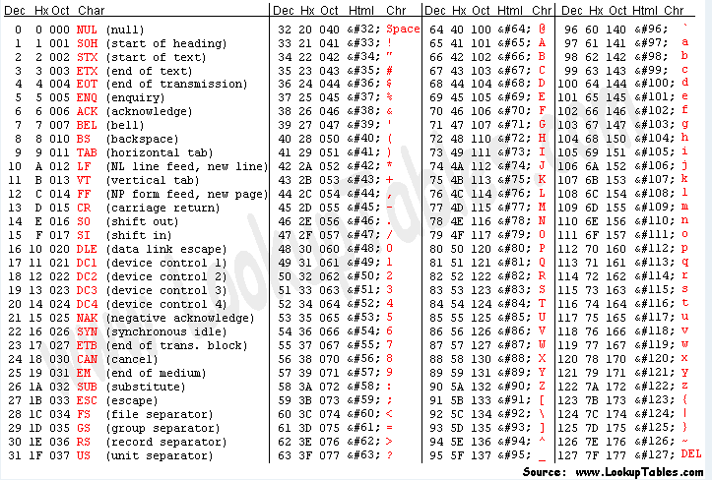
ASCII Characters

Slide 12
Challenge 1: How to Control Our Car Using ‘RF’
Think about this??

Slide 13
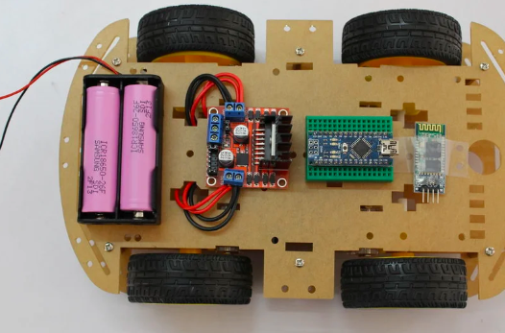
Battery Solution for Our Car
18650 Li-on Battery (2x)
18650 Battery Holder
Battery charger

Slide 14
Publications
Photon – TISB Publication for Physics & Technology -> Find info
EFY (Electronics For You) – efy.in –> Will send by End of October
efylab@efy.in
efyeditorial@efy.in
IET (Institution of Engineering & Technology) – theiet.in -> Getting the info
IEEE (Institute of Electrical and Electronics Engineers)
GitHub – Create an account – Start contributing

Slide 15
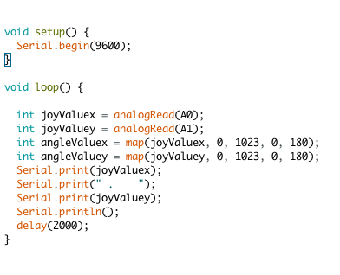
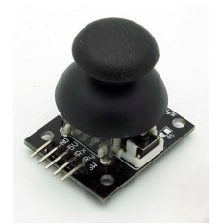
Joy Stick

Slide 16
Challenge 2:
How can we control a LED using Joystick?
How can we control a LED using Joystick through RF?
Give a thought..

Slide 17
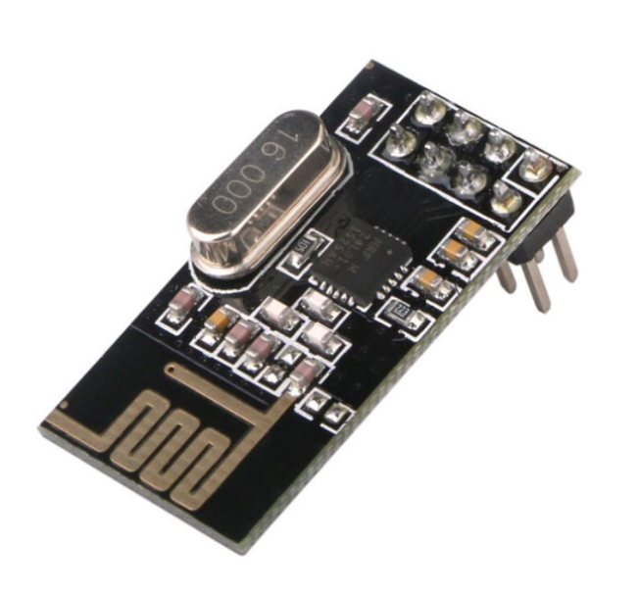
nRF - Description
nRF24L01
This module is designed for long distance and fast transmission of data.
It is designed to work through an SPI protocol.

Slide 18
Library
Sketch -> Include Library -> Manage Libraries
RF24 by TMRh20

Slide 19
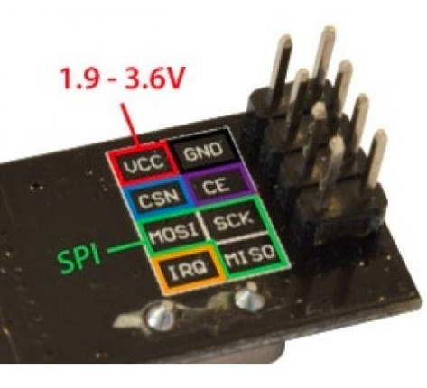
Connections

Slide 20
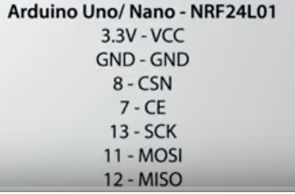
Connections

Slide 21
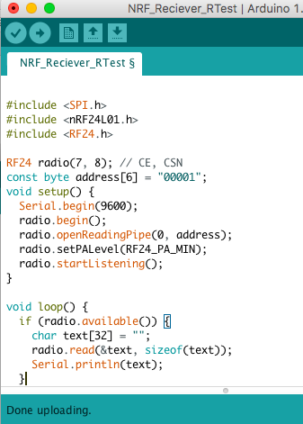
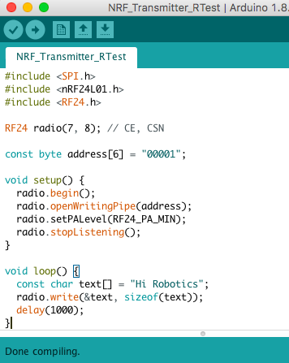
Simple Code

